Slide 1

Project Title -Airbnb Hotel Booking Analysis: Uncovering Insights from the NYC Lodging Market
[ Dikshita Bhagwan Parate]
[INTERNSHIP_17546440516895be537820f]

Slide 2

PROBLEM STATEMENT
Problem Statement: The hospitality industry is rapidly changing due to online platforms like Airbnb. This project utilizes the New York City Airbnb dataset to extract
meaningful insights that illuminate the dynamics of the city's lodging market.
Goal: The research aims to understand key factors influencing booking trends, pricing strategies, and overall customer satisfaction to contribute to a deeper understanding of Airbnb's operational landscape in a complex urban environment.

Slide 3
Project Description
This project analyses Airbnb hotel-style bookings to extract actionable insights for hosts, property managers, and platform analysts. Using cleaned historical booking and listing data, the analysis identifies demand patterns, booking lead times, price sensitivity, occupancy drivers, and listing features that correlate with higher revenue and guest satisfaction. The outcome is a set of data-driven recommendations, visual dashboards, and reproducible code that help hosts optimize pricing, improve listing attributes, and plan inventory for peak seasons.

Slide 4

WHO ARE THE END USERS?
Airbnb Hosts and Property Managers Need: pricing guidance, occupancy forecasts, amenity ROI suggestions, cancellation-risk signals.
Revenue/Commercial Teams (Short‑term Rental Companies) Need: dynamic pricing rules, market-level demand curves, competitor benchmarking, channel-mix recommendations.
Operations and Guest Experience Teams Need: peak staffing schedules, cleaning turnover planning, common reasons for cancellations and negative reviews.
Potential and Returning Guests Need: clear price expectations, best-value date ranges, filters for high-conversion amenities and policies.
Platform Product Managers and Data Teams Need: validated features and KPIs (ADR, occupancy, lead time), A/B test ideas, metrics to track marketplace health.
Local Tourism Boards and Destination Managers Need: seasonality insights, visitor origin trends, event-driven demand signals for marketing and infrastructure planning.

Slide 5

Technology Used
Programming Language: Python
Widely used for data science and powerful for handling large datasets.
Development Environment: Jupyter Notebook / Google Colab (Implied by the .ipynb file)
Used for interactive development, combining code, output, and visualizations in one place.
Core Libraries:
Pandas: Essential for high-performance data manipulation, loading, cleaning, and preparing the dataset.
NumPy: Used for fast and efficient numerical operations.
Matplotlib.pyplot & Seaborn: Utilized for creating static, informative, and customized statistical data visualizations (like bar charts, regression plots, and box plots).
Plotly Express: Imported for generating concise, interactive data visualizations (if used in the full analysis).

Slide 6
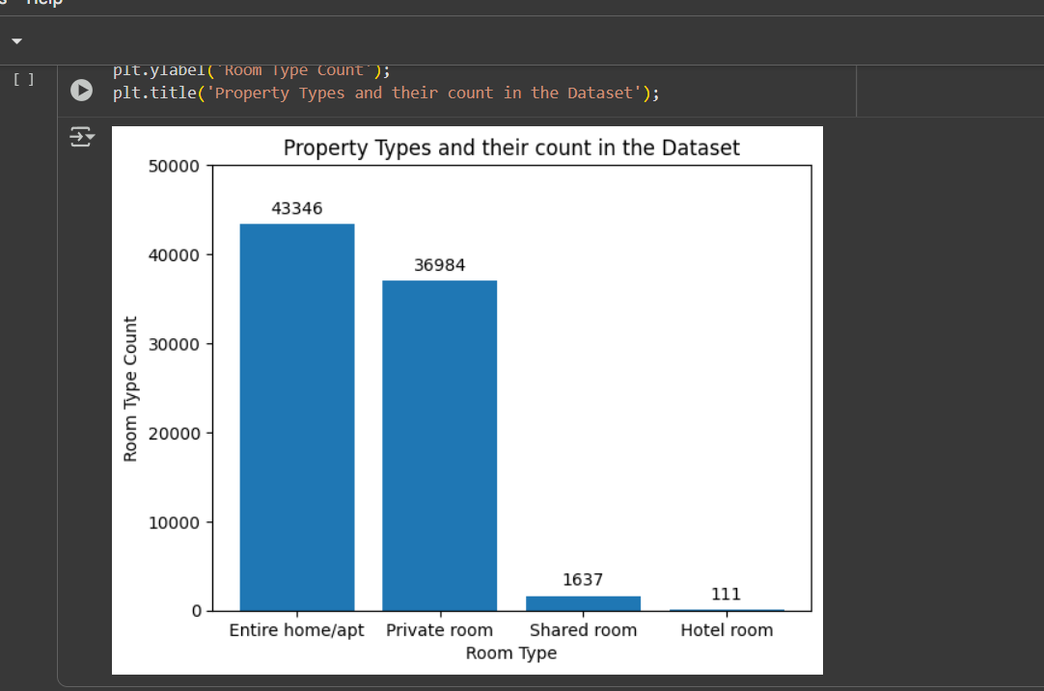
RESULTS1
[Add screen shots of your code or Chart(s) ]
Demo Link

Slide 7
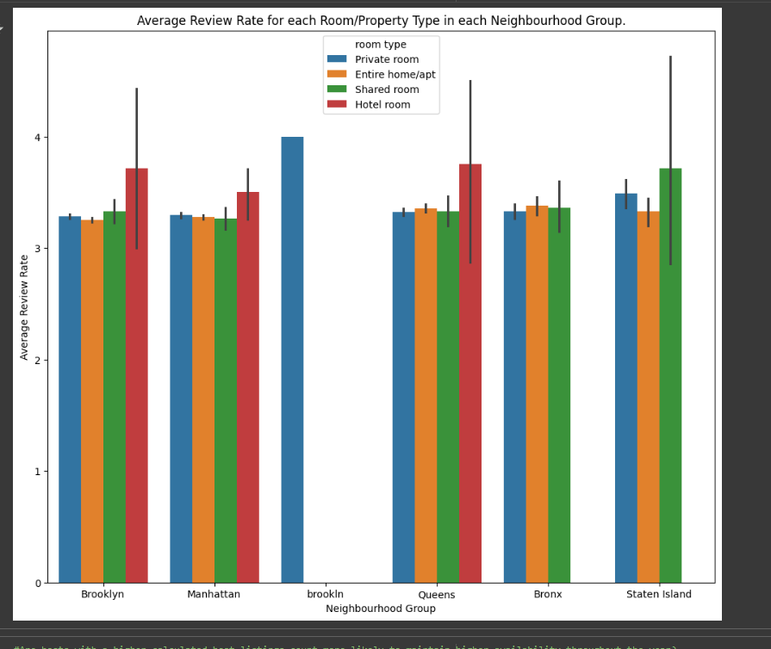
RESULTS2
Demo Link

Slide 8
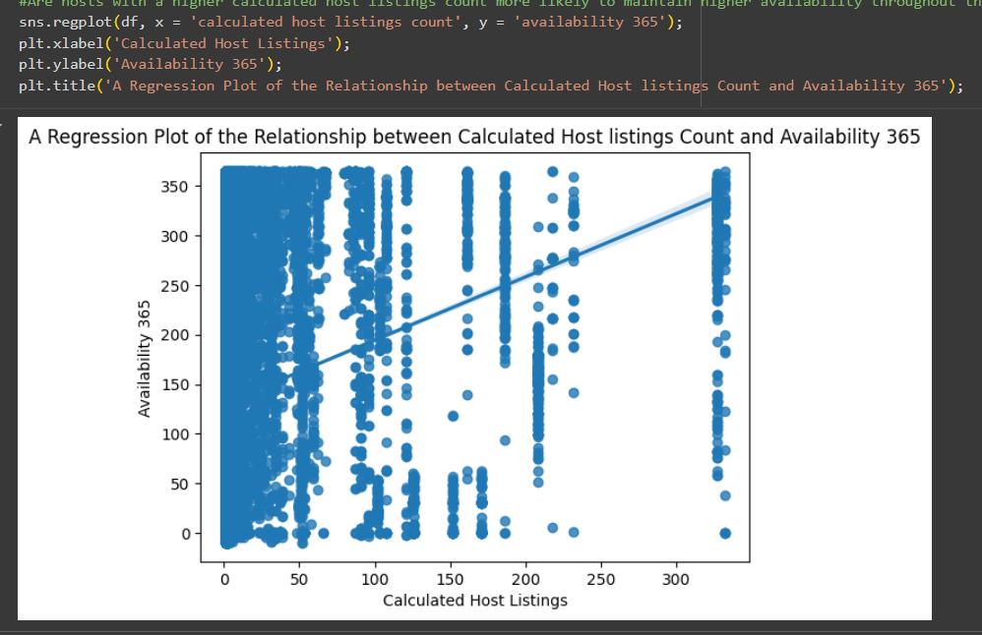
RESULTS3
Demo Link

Slide 9
GitHub repository
[https://github.com/Dikshita143/VOIS_AICTE_Oct2025_Dikshita-Parate.git]
Demo Link

Slide 10
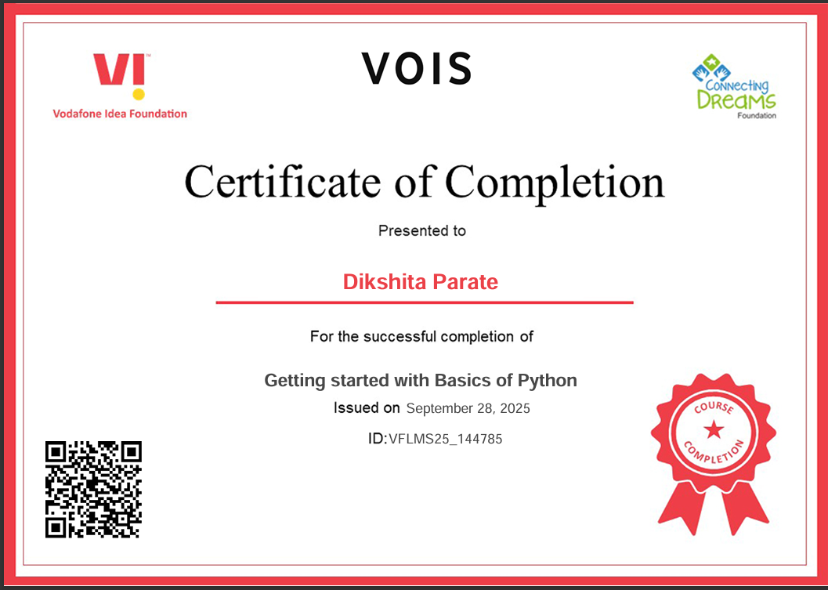
Getting started with Basics of Python Certificate

Slide 11
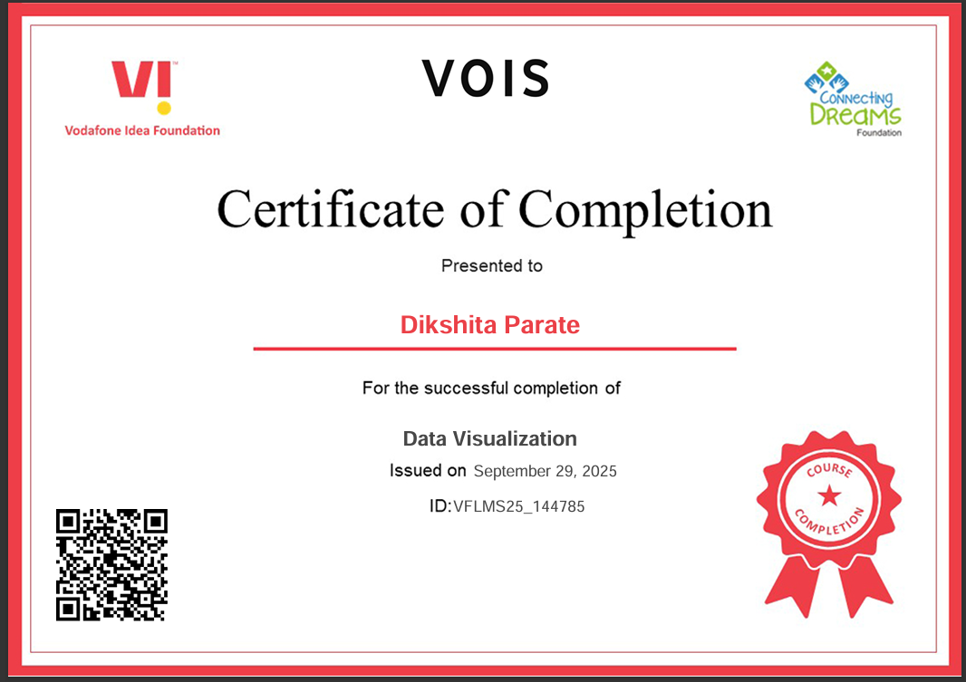
Data Visualization Certificate

Slide 12
Thank you
.
.

